Slide 1
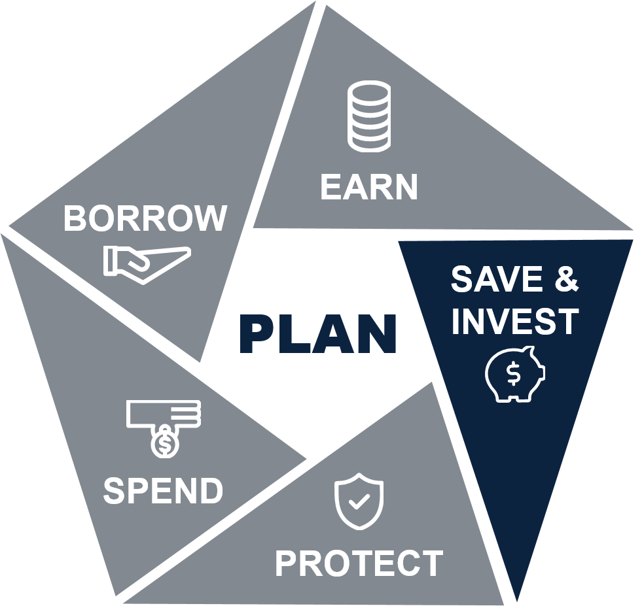
Getting Married
Basic
Personal Financial Management Curriculum
Version 1
Notes:
Lesson Introduction: 2 minutes.
Introduce the lesson.
Welcome to Getting Married.

Slide 2
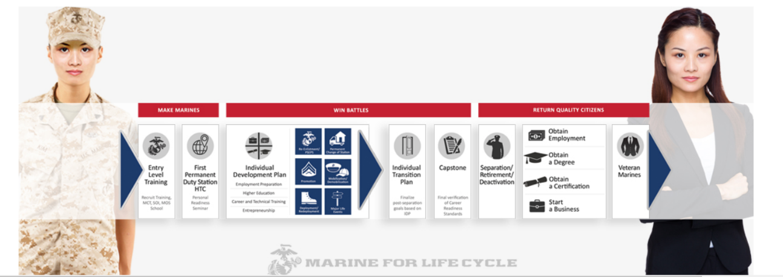
Marine Life Cycle: Major Life Events
Single living in quarters
Moving-off base
Buying a car
Getting married
Having children
Buying a home
Increasing assets
Divorce
Retirement/separation
Death
Notes:
Explain that getting married is of of life’s major events.
Getting married is a very exciting time in your life. However, all major life events are complicated in their own way. For Marine families every phase of life has its own unique financial challenge.
It is important that you understand these challenges as well as the resources that are available to you in managing these challenges.
This can help you make informed decisions, minimize stress, avoid financial difficulties, and assist you and your loved ones to start off on the right foot no matter what major life event comes your way.

Slide 3

Lesson Objectives
Analyze the financial considerations of marriage
Examine the importance of creating spending plans for time at home and on deployment
Notes:
Provide the learning objectives.
After completing this lesson, you should be able to:
Analyze the financial considerations of marriage
Examine the importance of creating spending plans for time at home and on deployment
Transition to the first topic.
We will begin this lesson by learning about the importance of financially preparing for marriage.

Slide 4

Share Financial Information
Prior to marriage:
  Discuss each other’s current financial situation
  Share income, debts, expenses
  and credit reports
This allows both partners to:
  Get a glimpse of their full financial picture
  Identify how it will impact the other person
  Enable them to make sound financial decisions together
Notes:
Preparing for Marriage: 7 minutes.
Explain the importance of sharing financial information with your partner.
The decision to get married is one of the most important financial decisions a couple will make together.
Prior to marriage, engaged couples should:
Discuss each other’s current financial situation
Share information about income, debts, expenses, and credit reports
This is an important step as it allows both partners to:
Get a glimpse of their full financial picture
Identify how it will impact the other person
Enable them to make sound financial decisions together
Once they have a full grasp of their current financial situation, couples can create a realistic budget and set short- and long-term financial goals.
Ask:
What could be the impact of not having this discussion?
Possible responses include:
The marriage could come under stress due to financial issues.
The couple may discover they have very different feelings about saving and spending money.
One partner may bring a large amount of debt to the marriage without the other’s knowledge.

Slide 5

Having a Financial Discussion with Your Partner
Learn about your “money personality”
Start the conversation in a non-threatening way
Gather any documents you might need
Talk about your financial goals
Keep emotions in check
Set a shared goal for something fun together
Ask for opinions and listen
If needed, identify where to get financial help
Set a dedicated time to discuss finances
Notes:
Review tips for having a financial discussion with your partner.
Finances are at the top of the list of decidedly unsexy topics to discuss with your partner. But money is a leading source of relationship stress and divorce.
So, while it might not be romantic, financial conversations are essential to the health of your relationship.
Some tips to start the process:
Learn about your “Money Personality” and your spouse’s “Money Personality”
Start the conversation in a non-threatening way
Gather any documents you might need
Talk about your financial goals
Keep emotions in check
Set a shared goal for something fun together
Ask for opinions and listen
If needed, identify where to get financial help
Set a dedicated time every week or month to discuss finances
If you are not comfortable talking with your spouse about money, then a good option is for both of you to take the PFM course Money Habitudes: Discover Your Money Personality.

Slide 6
Financial Questions to Discuss
What are your financial goals? Are they similar?
How will you handle savings and debt brought into the marriage?
Will you combine financial accounts, such as bank accounts and credit cards?
Will individual assets become jointly owned?
Are you both willing to write out power of attorney that includes the ability to make financial decisions?
Will you both be able to stick to an agreed spending plan?
Will both partners work after marriage?
Notes:
Review financial questions to discuss with your partner.
This list provides an overview of questions that you should discuss with your partner.
What are your financial goals? Are they similar?
How will you handle savings and debt brought into the marriage?
Will debts and savings be treated as new marital property or will each spouse retain responsibility and ownership?
Will you combine financial accounts, such as bank accounts and credit cards?
Will individual assets become jointly owned?
Most states allow for an individual to retain individual ownership of assets brought into the marriage along with gifts that are held separately after marriage. If one or both partners has concerns, they should seek legal advice.
Are you both willing to write out power of attorney that includes the ability to make financial decisions?
Will you both be able to stick to an agreed spending plan?
A spending plan based on marital income, debt, and expenses that are a true reflection of their situation can be created and agreed upon prior to marriage.
This will ensure that they both understand each other’s issues or baggage prior to marriage and can determine if they can work through it.
Keep in mind, though, that creating a spending plan may be one thing but sticking to it is another.
Will both partners work after marriage?
Your spouse can add to family income by working. However, when making your decision, you need to look at the true financial benefits and costs, beyond take home pay. Factors that can affect the financial viability of working include commuting costs, daycare expenses, insurance costs, and even tax implications.
Ask:
What are some other topics to discuss?
Possible responses include:
How money was handled in each of their families.
Who will pay bills?
Major purchases, such as buying a house.

Slide 7

Pre-Marital Resources
Personal Financial Management Program (PFMP)
Marine Corps Community Services (MCCS)
  PREP
  L.I.N.K.S
  LifeSkills Training and Education
Family Member Employment Assistance
Military OneSource
Navy Chaplains
Notes:
Review pre-marital education programs that are available to Marines.
According to statistics from the National Center for Health Statistics (NCHS), marriages are more successful and enjoyable when couples go through pre-marital education programs and pre-marital counseling prior to saying, “I do.” This can lead not only to a significantly happier marriage, but it can reduce the stress of the pre-wedding period.
Pre-marital education opportunities that are available to Marines include programs through the Marine Corps Community Services (MCCS) (although you and your spouse can and should take advantage of these resources even after you get married):
Personal Financial Management Program (PFMP), which offers financial education and financial counseling free of charge to Marines and their families.
Prevention and Relationship Enhancement Program (PREP) is a skills-based training program that teaches married or engaged couples communication skills and ground rules for handling conflict and promoting intimacy. The program’s aim is to prevent future marital problems including violence and divorce.
To find out about pre-marriage seminars available in your area, check with your installation Marine Corps Family Team Building (MCFTB) or the Chaplain’s Office.
L.I.N.K.S. (Lifestyle, Insights, Networking, Knowledge, and Skills) is a volunteer, team-mentoring program designed by Marine Corps spouses.
This program offers an orientation to the Marine Corps lifestyle, which helps spouses, Marines, children and teens, and parents/extended family members understand and adapt to the unique challenges Marine Corps life often presents.
The program works through a partnership of volunteer spouses, MCFTB staff, Marine Corps career retention specialists, and Chaplains. They provide a positive environment for Marines and their families to learn to manage the demands of the Marine Corps lifestyle, and to learn to work together as a team in balancing family needs while meeting Marine Corps expectations.
Participants receive real-life tips, information on Marine Corps culture and available resources that enable them to help themselves. Information provided as part of the curriculum includes financial awareness and effective communication.
LifeSkills Training and Education is a comprehensive collection of personal and professional skill building classes that promotes positive adjustments and improved individual and family functioning. It provides Marines and family members practical skills for successful interactions and positive outcomes at work, home, and in life.
Family Member Employment Assistance Program provides employment related referral services, career and skill assessments, career coaching, job search guidance, portable career opportunities, and education center referrals/guidance.
Military OneSource is a good resource to use when you are looking for pre-marital education and counseling. Their trained staff will be able to direct you to the appropriate resources.
Navy Chaplains give classes and individual pre-marital counseling, depending on the installation. Check with your base Chaplain’s Office to find a list of current classes or make an appointment for pre-marital counseling.
Transition to the next topic. If you are going to teach Money Habitudes ® move to that. If not move forward to discussing the financial benefits and considerations of marriage

Slide 8






Activity: Money Habitudes® Solitaire
Keep in mind…
This is not a test.
There are no right or wrong answers.
Think about today.
Go quickly—don’t be analytical or over think!
Notes:
Money Habitudes® Solitaire: 30 minutes.
Introduce the activity. (2 minutes)
Explain that now we’re going to complete the Money Habitudes® card sort to further explore our financial values and habits.
Tell the participants to keep the following in mind during this exercise:
This is not a test.
There are no right or wrong answers.
Think about today—not what you used to do or want to do in the future.
Go quickly—no analyzing or overthinking!
Pass out the Money Habitudes® Solitaire cards—one deck per participant.
Have the participants take the cards out and find the green instructions card.
Provide the following instructions for setting up the game:
Place the 3 sorting cards in front of you. The cards say “That’s me!”, “Sometimes…it depends…maybe…”, and “That’s not me!”.
Put the 8 yellow cards back in the box. You’ll use them later to interpret your cards after you’ve sorted them.
Shuffle the remaining 54 statement cards.

Slide 9
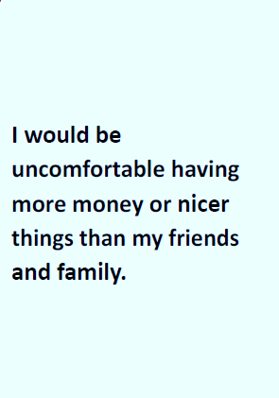
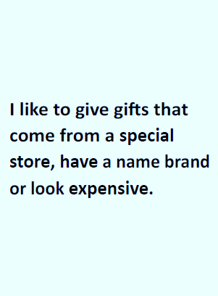
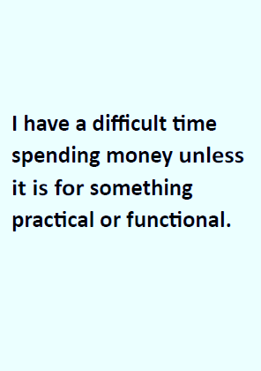
Play the Game
That’s me!
Sometimes…
it depends…
maybe…
That’s not me!
Notes:
Conduct the activity. (25 minutes)
Play the game.
Provide the following instructions for playing the game:
Hold the statement cards so the printed side is up. Read each statement card.
Place the statement card under the sorting card that best describes your reaction to the statement. Don’t think too much. There are no right or wrong answers.
For example: "I feel I should pay the bill when I eat out with others." If you usually feel like you should pay, put it under “That’s me!” If you don’t think you would pay for others, put it under “That’s not me!” And if it depends on who it is, or on the situation, put it under “Sometimes...it depends...maybe…”
Take about 10-15 minutes to play the game. When you’re finished, you can begin to interpret your cards.

Slide 10

When Interpreting the Cards, Remember…
No combinations are good or bad!
All habitudes are good.
Overusing any habitude may lead to challenges.
Underusing or missing any habitude may lead to challenges.
Key question: How are your habitudes working for you?
Notes:
Interpret the cards.
Tell participants to keep the following in mind when they interpret their cards:
All habitudes are good.
No combination is good or bad!
Overusing any habitude may lead to challenges.
Under using or not using any habitude may lead to challenges.
The key question is: How are your Money Habitudes® working for you?

Slide 11
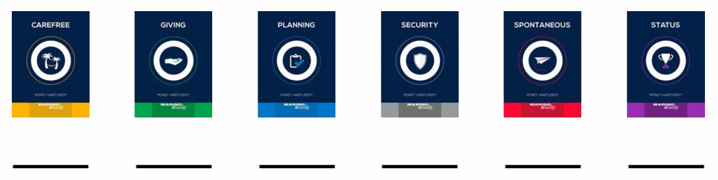
Sort the “That’s Me!” Cards
Notes:
Provide the following instructions for interpreting the cards:
Focus on the “That’s me!” pile. Put aside the other two piles, but keep them in piles.
Sort the cards in the “That’s me!” pile by the pictures on the back. Write down how many cards are in each Money Habitudes® category in your “That’s me!” pile. Write down how many there are altogether in your “That’s me!” pile.

Slide 12
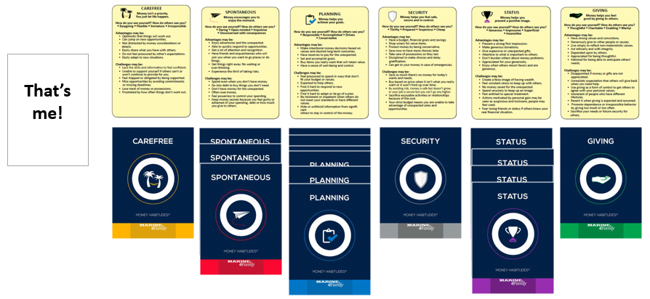
Interpret Your Cards
Notes:
Next, take out the yellow interpretation cards. Match the yellow cards to your “That’s me!” cards by the name and picture of the habitude on each card.
Read the yellow interpretation card for each habitude, beginning with the one that has the most cards in the “That’s me!” pile.
If you’re missing a habitude, read the yellow interpretation card that describes it. Consider if there are advantages that would benefit you if you used this habitude more.
Look for patterns. Ask yourself—Which habitude do I use when I feel good? When I’m stressed, angry, or tired? When I feel proud or have regrets? What people, situations, or stressors cause me to switch to a different habitude? How do my habitudes conflict with or complement the significant people in my life?
Debrief the activity. (3 minutes)
Ask:
How many people had more than 20 cards in their “That’s me!” pile?
Generally this indicates that you are pulled in different directions, and even if you have good intentions, it may be hard to follow through.
Does anyone have fewer than 10 cards in their “That’s me!” pile?
This typically indicates that you are very clear about what is important to you; however, it may be difficult to stay open to new ways of looking at things.

Slide 13
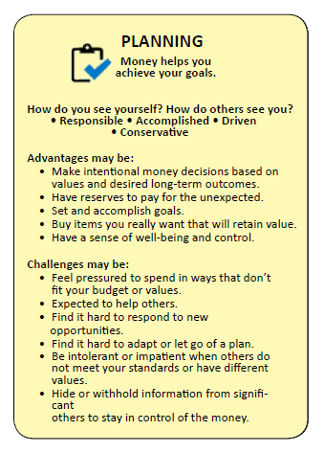
Dominant Habitude
How do you see yourself?
How do others see you?
Challenges may be…
Advantages may be…
Notes:
Explain dominant habitudes.
If you have 4 or more cards in any one habitude, this is a dominant habitude. That means this is your default way of thinking and behaving, especially during times of stress or high emotion.
There are 9 cards for each habitude. If you have 7, 8, or 9 cards in your dominant habitude, it’s a very strong message and you’re more likely to use that habitude very consistently.
Ask any of the following questions for discussion:
Does your dominant habitude accurately describe how you would like to handle your money?
How does it change when you are upset, angry, stressed, or under pressure?
Who has more than one dominant habitude? How does that work for you?
Who has a missing habitude? What are they?
How can you use your understanding of your habitudes and triggers to help you reach your financial goals?
Transition to the next topic.
Good money management is a mix of information, skills, and confidence. If you want to make wise choices, have financial stability, and successfully prepare for your financial future, consider your Money Habitudes® results to help you determine how to focus and take the path to success.
Now we will brainstorm the characteristics of a financially fit Marine.

Slide 14

Financial Benefits of Marriage
Increased BAH and additional housing options
Health insurance for the spouse and children
Family separation allowance
Relocation reimbursement for moving expenses
VA home loans (also available to non-married)
Unemployment compensation for trailing spouses
Educational benefits that extend to spouses and children
Free military air travel based on availability
Commissary privileges that provide 30% savings and tax-free shopping
Notes:
Financial Benefits and Considerations: 5 minutes.
Discuss some of the financial benefits that are available to Marines after marriage.
Military members who decide to get married while on active duty have many benefits available to them and their new family members (who MUST be registered dependents in DEERS):
Increased Basic Allowance for Housing (BAH) and additional housing options, such as military housing units that may be available.
Health insurance that will cover the spouse and children. A variety of spouse and family health care options exist in TRICARE and sometimes you may have to pay a portion of the cost for a health service or prescription. You have 90 days from the date of your marriage to update your TRICARE plan—to add your spouse, who must be in DEERS (as of 2019). As mentioned already there are several options, and the best place to learn about them is on the TRICARE website at: https://tricare.mil/LifeEvents/Marriage). The TRICARE Compare Cost Tool can help. Find it at: https://tricare.mil/Costs/Compare)Family separation allowance, which helps to financially compensate for spouses being away from the family due to deployment.
Relocation reimbursement for the cost of moving spouses and children during a permanent change of station (PCS).
Department of Veterans Affairs (VA) home loans, which allow for zero money down to buy a home. (This program is also available to non-married Service members.)
Unemployment compensation for trailing spouses. More than half of states now provide unemployment compensation to military spouses who, because of military transfers, must leave their jobs.
Educational benefits that extend to spouses and children of Marines. Military spouses have access to programs, grants, and scholarships that can help pay for education and credentialing. If you or your spouse are interested in pursuing your education, check them out. To learn more, reach out to the Family Member Employment Assistance Program (FMEAP) or Voluntary Education staff at your installation.
Free military air travel based on availability.
Commissary and Military Exchange privileges, which allow military families to save up to 30 percent and shop tax-free.
The Marines also have many free resources listed on the MCCS website. These include everything from advisors in finances to military spouse employment and more. These free resources can help your family save money.
Savings in all these areas can add up quickly. The financial benefits to being married in the military are considerable and should be taken advantage of by Marines and their families.
Ask:
What other benefits can you think of?
Answers will vary.

Slide 15

Financial Considerations Affected by Marriage
Estate planning
  SGLI and TSP beneficiary automatically become your spouse
  Creating and/or revising your Power of Attorney
  Creating and revising your Advanced Medical Directive (AMD)
Tax Implications
  Determine if you want to file “Married filing jointly” or “Married filing separately”
  Review your tax withholding
Notes:
Discuss financial consideration that they should also address.
Along with benefits, there are also special considerations that you should address.
Review your estate planning.
After marriage, your SGLI and TSP beneficiary defaults to your spouse. If you want it to be different (for example, your spouse gets half and your parents half) you will need to change your designation.
If you have a Power of Attorney, you may now want to change it to your spouse. If you do not have a Power of Attorney, you should set it up now. Base Legal can help with this.
You should also review other important documents such as your will and your “living will” or Advanced Medical Directive (AMD). Make you are up-to-date and comfortable with your designated decision-makers.
Review your tax situation.
After marriage, your tax status will change. You will have the option to file as “Married filing jointly” or “Married filing separately.”
Often, married couples get a tax break when “married filing jointly” but VITA and MilitaryOneSource’s Military Tax Consultants (https://www.militaryonesource.mil/financial-legal/tax-resource-center/tax-services-benefits) can help you decide what is best for you; PFMs are not tax advisors.
Transition to the next topic.
Now let’s talk about briefly about financial obligations if you marry a non-U.S. citizen.

Slide 16
Marrying a Non-U.S. Citizen
To marry in the U.S.
I-129F
6 months
$535
If already married, to come to the U.S.
I-130
6 months
$535
U.S. Citizenship and Immigration Services toll-free military help line: (877) 247-4645
Notes:
Marrying a Non-U.S. Citizen: 3 minutes. (Optional)
Instructor Note: Use if any course participants are married or getting married to a person who is not a U.S. citizen. If not, then skip this section. If so, ensure it is covered.
Introduce the topic.
Many Service members find and fall in love with people who were not born in the United States and are not U.S. citizens. This situation brings its own set of financial obligations that need to be taken into consideration.
If not yet married: Immigration laws require time and money to get your new spouse into the United States. Planning ahead can make traveling with your new spouse allowable in a shorter period of time. If you choose to bring your fiancé/fiancée to the United States to get married, you will have to fill out Form I-129F (Petition for Alien Fiancé[e]) six months before your travel date; it has a $535 filing fee (as of 2018).
If you are already married: You will need to submit an I-130 (Petition for Alien Relative) six months before traveling to the U.S., and it will cost $535 (as of 2018).
This is just the beginning when it comes to the immigration process, which is complicated and lengthy. So, do your research first and plan!
U.S. Citizenship and Immigration Services (USCIS), has established a toll-free military help line, 877-CIS-4MIL (877-247-4645), TTY (800) 877-8339 and e-mail address at militaryinfo@uscis.dhs.gov exclusively for current members of the military and their families as well as veterans. Further information can be found by using this free resource.
Transition to the next topic.
Now let’s look at the developing a budget or spending plan that works for both of you.

Slide 17
Developing a Spending Plan
Develop two spending plans for expenses when at home and when deployed
Bring all income, debts and expenses
“to the table”
Categorize short- and long-term debts
Add up all income, debts and expenses
Set up a budget
Notes:
Developing a Spending Plan: 10 minutes.
Introduce the topic.
Military couples should consider developing a spending plan as soon as possible. It is best to develop two separate spending plans. One spending plan to cover expenses while the military spouse is at home and one for when the spouse is deployed (but let’s start with just one).
Ask:
Why is a spending plan important when getting married?
Possible responses include:
Your income may change
Your expenses will change
One or both you may be bringing debt into the relationship
Financial goals now need to reflect goals as a couple and not as an individual
Building a spending plan can help you discuss financial issues that may be uncomfortable
Expand upon the topic.
Salaries often vary substantially when the Marine is deployed, so partners need to agree on how this extra money is going to be spent, or whether it will be saved, used to pay down debt, invested, or even used to purchase something special for the family. These are important topics to be discussed during the spending plan process.
This section will provide only a brief overview on spending plans. The PFM curriculum offers a course specifically on creating a spending plan. I recommend you take that course or set up an appointment with me or another PFM, to work together on creating your spending plan.
When creating your spending plan, you should bring all income and debts to the table: The best way to start talking about your budget is to bring all your “cards to the table.” This means everything. Bring your most recent pay stubs, leave and earnings statements, as well as copies of all your bills. This includes car payments, insurance payments, allotments, credit card bills, store credit, bank statements, layaways, student loan information, etc. You should also each review your credit reports.
Ask:
Why is it important to review your credit reports as part of this process?
Possible responses include:
To ensure it adequately reflects you and your partner’s individual situations
To ensure you and your partner both have a clear picture of your financial situation
To take during the spending plan process to address any problems that may have been uncovered
Remind the participants that the PFM curriculum also includes lessons on Credit and Debt Management.
Ask:
How might your insurance needs and costs change when you get married?
Possible responses include:
You may want to increase the coverage on your renter’s or homeowners insurance to include your partner’s belongings
You may want to purchase life insurance for your partner
You may want to update or merge your car insurance policies
You’ll need to ensure you have healthcare for your non-military spouse
Continue discussing the spending plan process.
Categorize information: Once both partners bring their information to the table, you can then begin categorizing your information. Put short-term debt, credit cards, and layaways in one category. Long-term debt, such as school loans, car loans, or boat loans goes into another. If there is real estate, that has its own category. It is also a good idea for both individuals to track their spending on ATM/Debit cards which can add up just as quickly as debt.
Add up all income and debts: After all the incoming money is added together and all the outgoing debt added together, you will have a clearer picture of how much extra money you will have as a couple to spend on “fun” activities.
Set up a spending plan.
If one spouse earns substantially more income or one spouse has substantially more debt, it is wise to see a financial specialist.
You may want to set up some percentage-based payments. Percentage-based payments give the situation a monetary percentage about who is paying how much for what. If this approach works for both spouses, it may contribute effective handling of the couple’s financial arena and potentially help to avoid conflict.
There are many other ways to approach creating a spending plan. Leverage your PFM specialist or CFS to assist you in determining a budgeting method that is agreeable to both spouses. I encourage you to make an appointment for both spouses with the PFM.
Distribute the Handout: Spending Plan Worksheet.
This worksheet can be used to draft a spending plan.
You may also be able to find worksheets and apps online to assist you.
Review your plan and priorities every few months. It is critical to review your plan when you reach a major life event like marriage, birth of a child, promotion, PCS move, divorce, or transition to civilian life.
A spending plan is a “living document” that will change with your needs and situation. Your spending plan should be flexible enough to change with whatever comes your way.
It is also important to remember that budgeting is a process. Once you have a budget, you need to track what you are spending and compare it to your budget.

Slide 18

Set Savings Goals
Make sure to set saving goals as part of your spending plan
Savings goals could include:
  Wedding costs
  Planning for children
  Renting or purchasing a larger home
  Travel costs to visit both families
  Retirement
  Having a specific amount of money in an emergency fund
  Paying down debt
  Paying for education
Notes:
Emphasize the importance of setting savings goals.
Make sure to set saving goals as part of your spending plan.
Savings is an important consideration for a married couple. It can be even more complicated if one of you is a saver and one is a spender. Every couple has to find a balance that works for them but failing to save is a sure road to marital discord.
Savings goals could include:
Wedding costs
Planning for children
Renting or purchasing a larger home
Travel costs to visit both families
Planning for retirement, including saving a specific amount per month for each spouse’s retirement
Having a specific amount saved in emergency fund
Pay off or pay down debt, including student loan debt
Paying for one or both of you going back to school
Ask:
How might you meet your saving goals?
Possible responses include:
Create a separate account for a specific savings goal.
Begin or expand savings for retirement for both partners now.

Slide 19

Meeting Financial Obligations
Marine Corps expects all Marines to provide adequate and continuous financial support to family members
Marines:
  Are responsible for spouse’s and children’s financial well-being
  Must fulfill financial obligations even while deployed or face disciplinary actions
Notes:
Discuss the importance of meeting financial obligations.
The Marine Corps expects all Marines to provide adequate and continuous financial support to family members.
It is important that prior to getting married, Marines be well-informed of the requirements governing financial support of spouses and children.
Marines:
Are responsible for spouse’s and children’s financial well-being. As long as you are married to your spouse, you will be responsible for his or her financial well-being. Even if you are legally separated and or living apart, until the divorce is legal and final, you will still be responsible for their financial well-being.
Must meet financial obligations while deployed. While you are deployed, you will still be responsible for ensuring debts are paid on time, and for the continued support of your spouse and children.
If your chain of command finds you delinquent in meeting your financial obligations, disciplinary actions can be taken. These include counseling statements, letters of reprimand or admonishment, or awarded Article 15, nonjudicial punishment (NJP).
It is better, therefore, to be completely aware of the implications and financial responsibilities of marriage ahead of time, rather than be surprised later on.

Slide 20
Activity: An Important Talk about Family Finances
1. Complete the questionnaire.
2. Score the questionnaire.
3. Review your score.
Notes:
Activity: An Important Talk about Family Finances (8 minutes)
Introduce the activity. (1 minute)
Explain that this questionnaire is to assess how much you and your future partner know about each other’s finances and financial goals.
Emphasize that this information is for your use only. You do not need to share any of this information with the other people in the room.
If your partner is in the room with you, you should both complete the questionnaire and discuss it together later. If your partner is not here, you may take an additional copy of the questionnaire for him/her to complete later.
Conduct the activity. (6 minutes)
Complete the questionnaire:
Distribute the Handout: An Important Talk About Family Finances Before the Wedding.
Emphasize that to set off on a sound financial footing, you should answer every question.
Give participants about 5 minutes to complete the questionnaire.
Tell the participants they should score themselves after completing the questions.
Debrief the activity. (1 minute)
Ask (Optional):
Would anyone like to share thoughts or reactions to their initial financial communication score? Is it close to what you expected? Were you surprised by your score? Why?
Remind participants that the intention of this baseline score is to help identify potential challenges for communicating about potential financial issues. Having a completed sheet makes a great conversation starter if this is a topic that is difficult for them as a couple.
Encourage participants to share their results with their future partner and strategize actions they can take to make sure that they are financially secure.
Transition to the next topic.
Let’s summarize what we’ve discussed today.

Slide 21
Lesson Summary
Analyze the financial considerations of marriage
Examine the importance of creating spending plans for time at home and on deployment
Notes:
Lesson Summary: 3 minutes.
Summarize key learning points.
Now that you have completed this lesson, you should be able to:
Analyze the financial considerations of marriage
Examine the importance of creating spending plans for time at home and on deployment
Share upcoming classes about the topics that were covered in this lesson.
If you or your spouse want to learn more about any of the topics we have covered, there is probably an upcoming class on that topic and if there isn’t you and your spouse can (and should!) make an appointment with your PFM.
Classes include:
Money Habitudes: Discover Your Money Personality
Developing a Spending Plan
Communicating about Money
Exploring Your Financial Values and Habits
Introduction to Credit
Introduction to Debt Management
Establishing Savings
Death of an Active Duty Spouse (for those with AD spouses)
Death of a Spouse (for those with civilian spouses)
Introduction to Life Insurance and Purchasing Life Insurance
Ask:
Are there any questions or comments about Getting Married?
Distribute the resources handout.
This handout: Online Resources identifies where to get additional information.

